Slide 1
AZ-900 Workshop Part Trois
20 Questions in 15-30 minutes

Slide 2
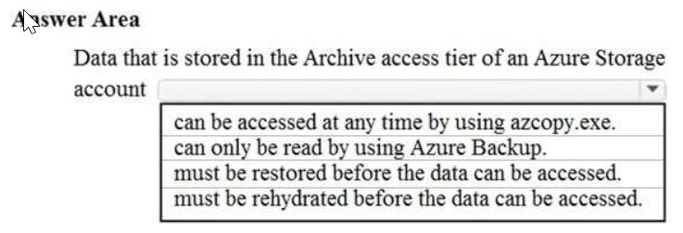
Q1

Slide 3
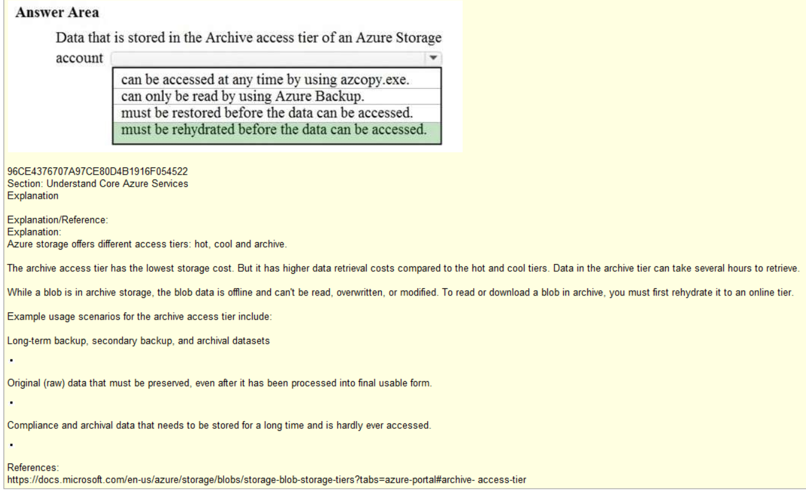

Slide 4
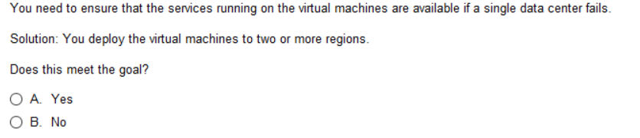
Q2
YES, highly unlikely two or more availability zones OR regions fail at exact same time

Slide 5
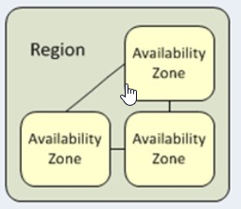
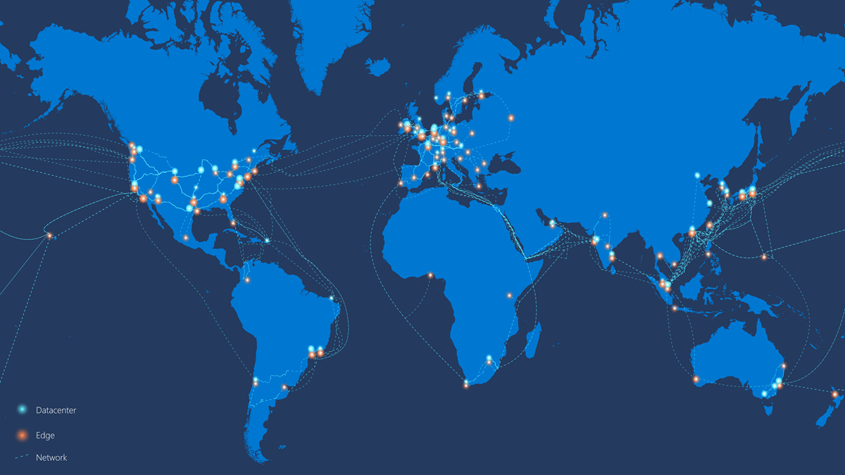
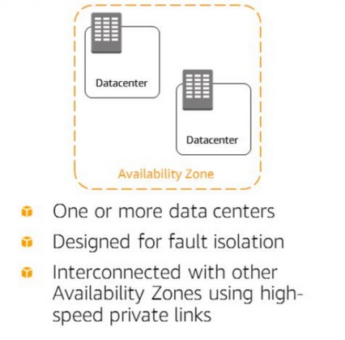
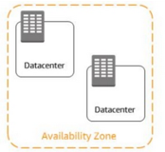
Azure Regions
CDN
Edge
Edge

Slide 6
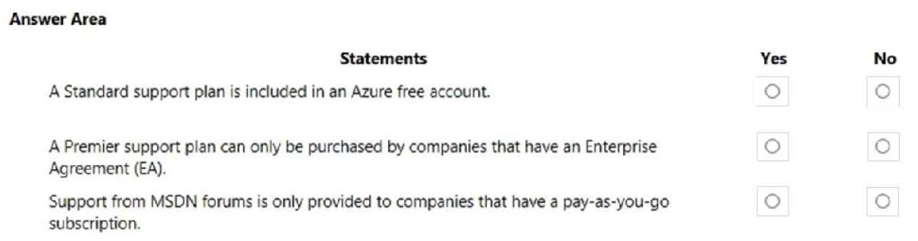
Q3

Slide 7
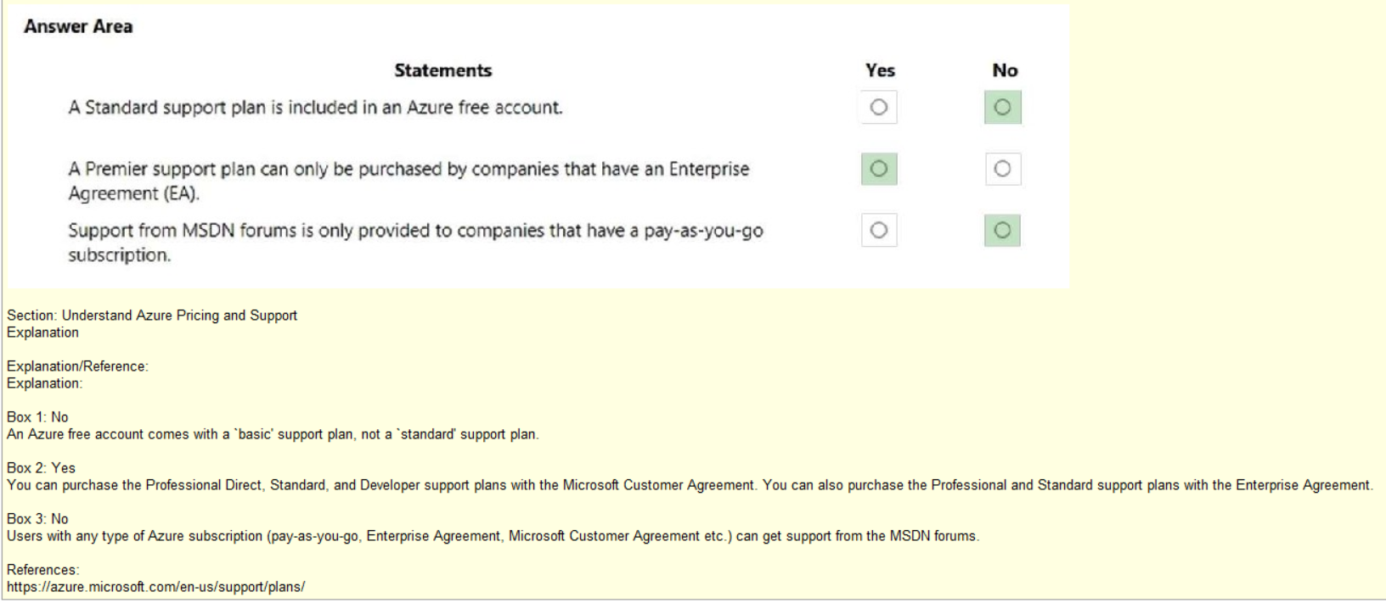
Tip: Some info not on the chart, only learn by reading reference

Slide 8
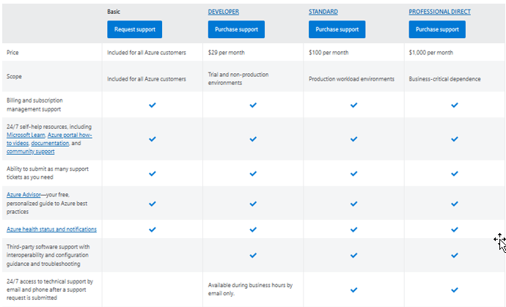
https://azure.microsoft.com/en-us/support/plans/
Tip: Commit to memory the variances
No Support
Requests

Slide 9
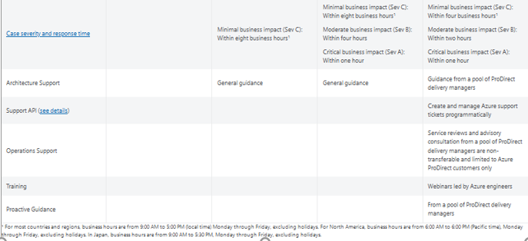
https://azure.microsoft.com/en-us/support/plans/
Tip: Commit to memory the variances

Slide 10
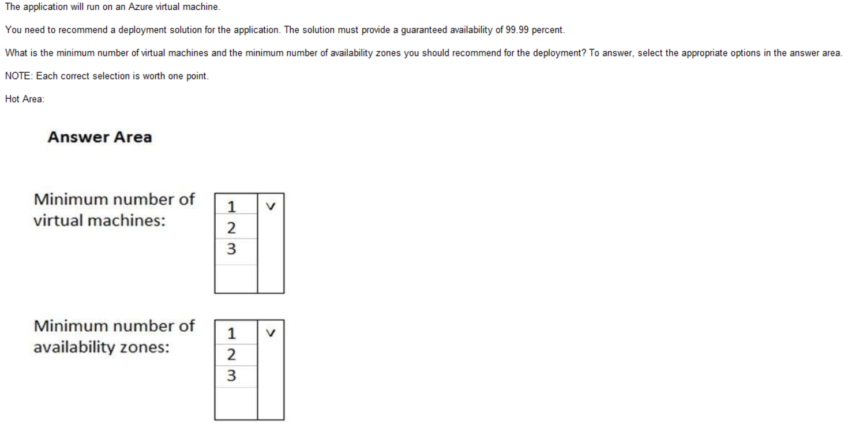
Q4

Slide 11
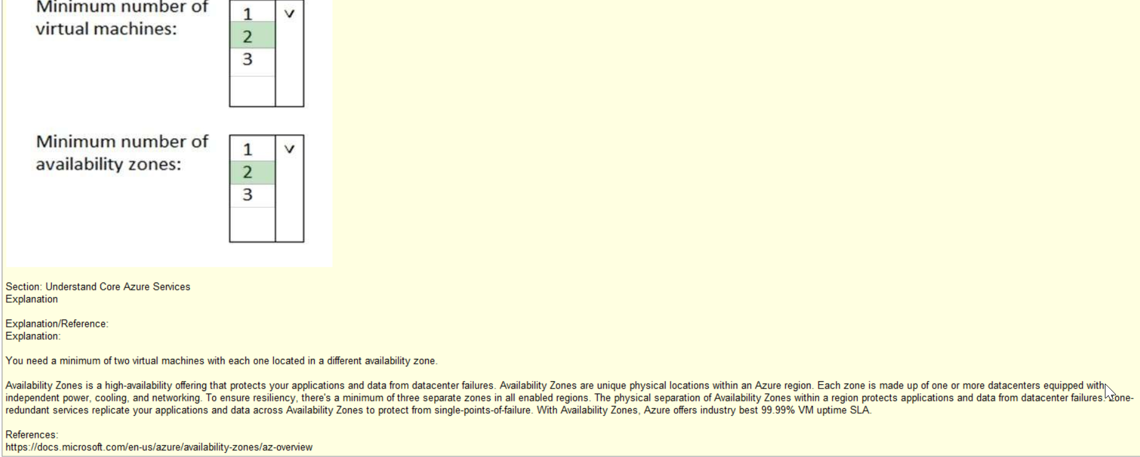

Slide 12
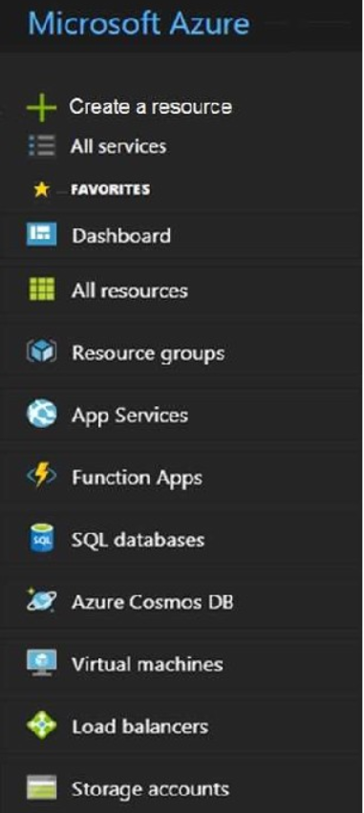
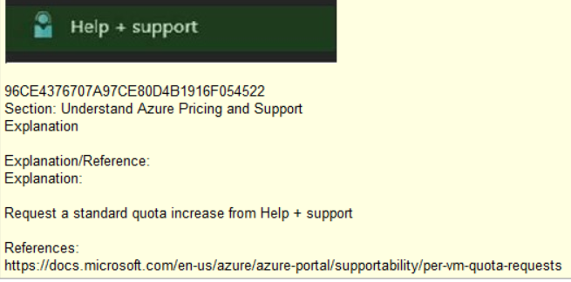
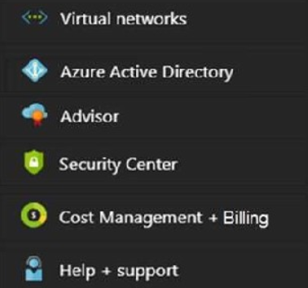
Q5
Tip: Learn what all these blades represent
By using your Microsoft Free Acct
Ans.
Ans.

Slide 13
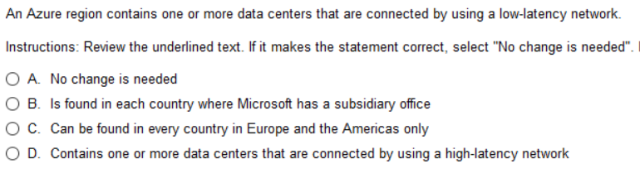
Q6

Slide 14
Azure Regions
CDN
Edge
Edge

Slide 15
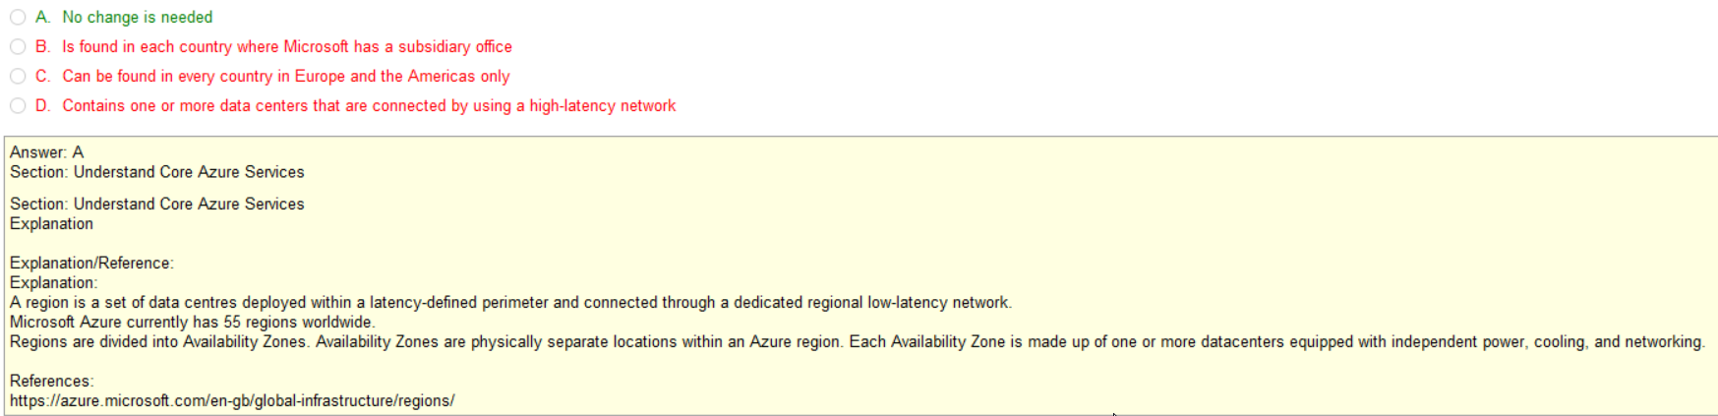
Region often covers multiple countries
Region often covers multiple countries
Definition of Availability Zone

Slide 16
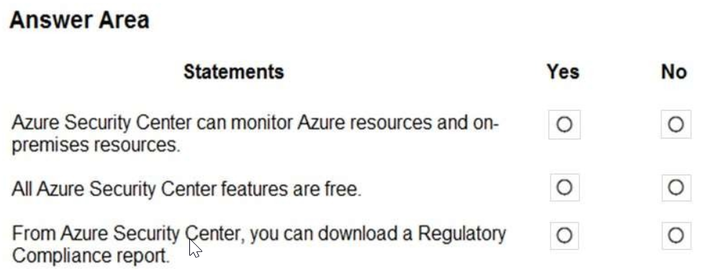
Q7
This may surprise some
But how else do you
Monitor Hybrid networks
Compliance Reports
For Security Audits too

Slide 17
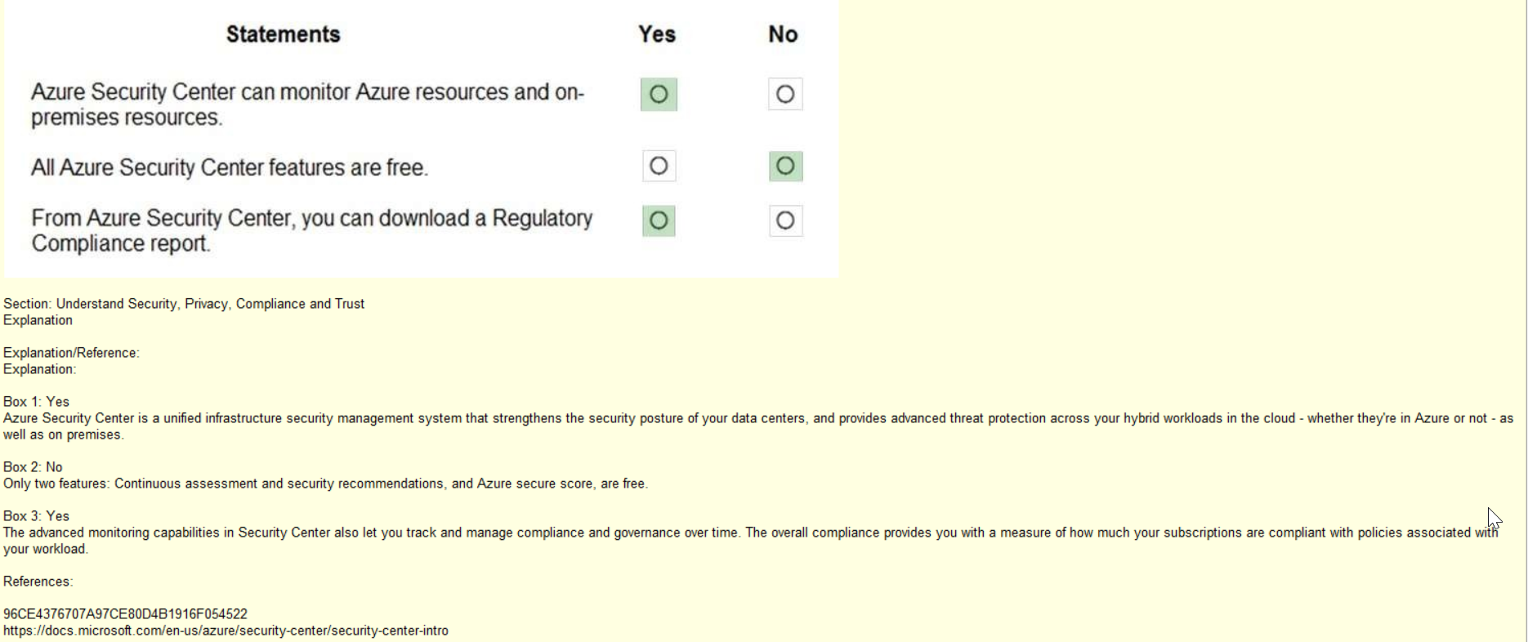
Note: How else could it monitor Hybrid network

Slide 18
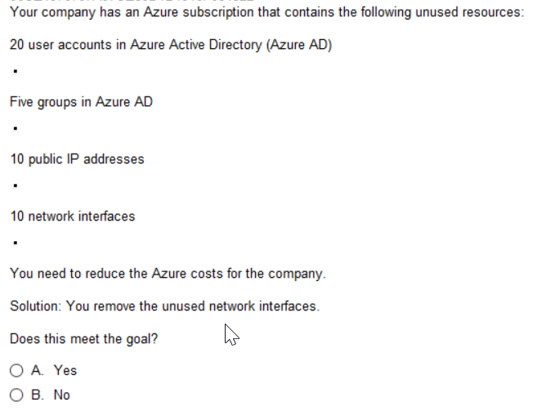
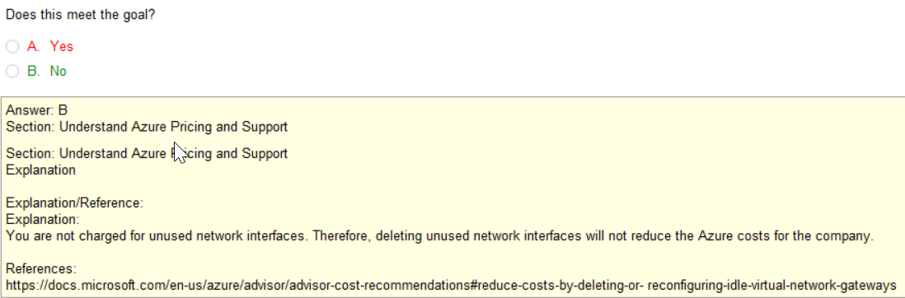
Q8
Azure Subscription contains
multiple user accounts up to 5000
Groups come at no Cost
Public IP addresses come with costs
Network interfaces come at no Cost

Slide 19
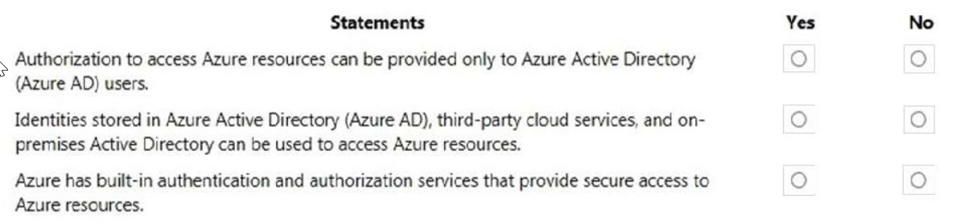
Q9

Slide 20
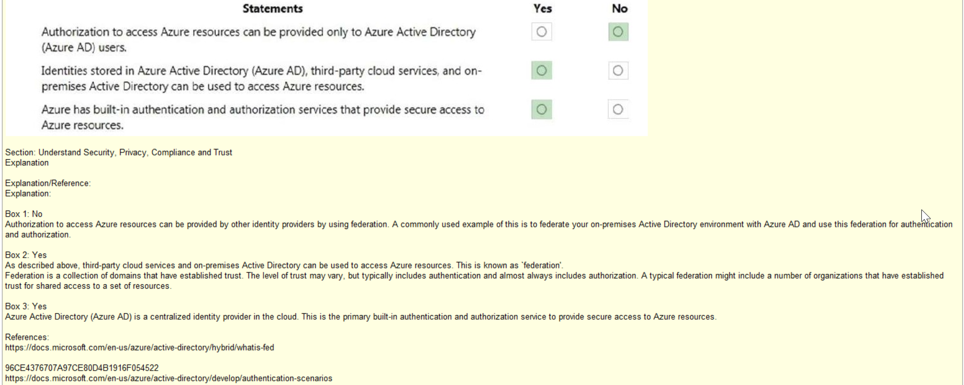

Slide 21
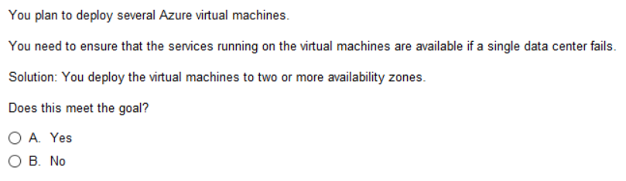
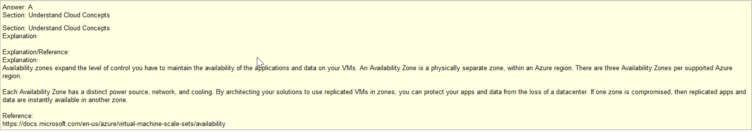
Q10
Tip: You must understand
The Region, AZ, DC concept
Same for this as with AWS
Only some variations with Edge

Slide 22
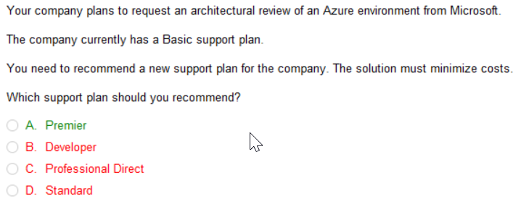
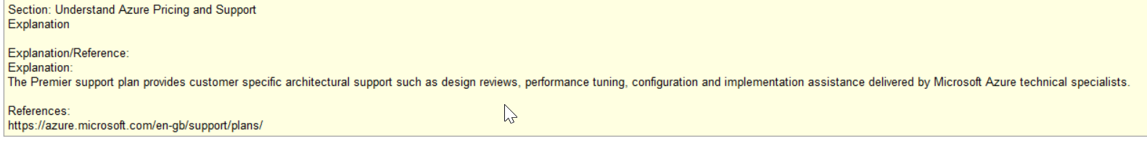
Q11

Slide 23
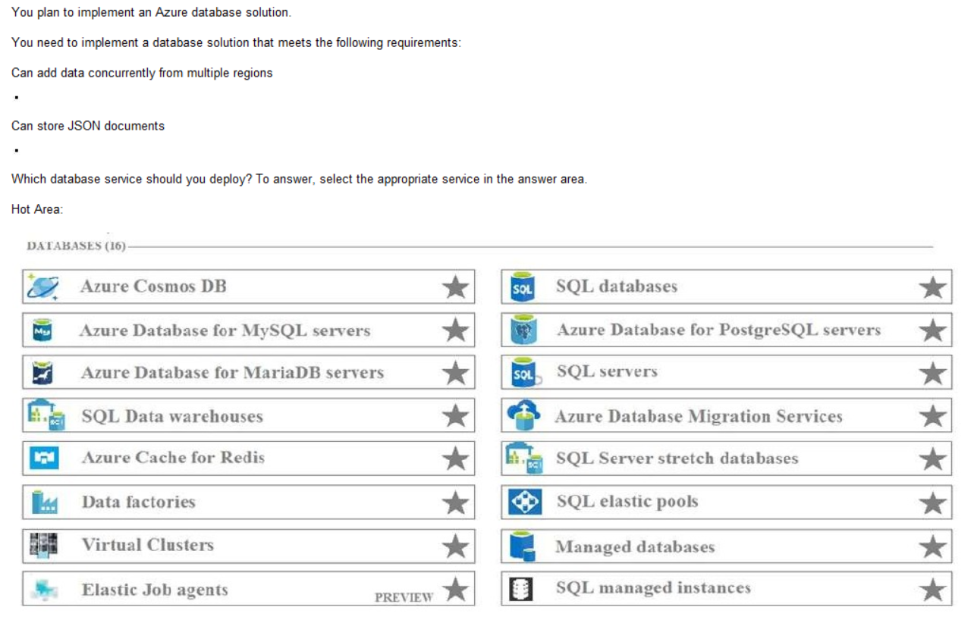
Q11
Tip: they didn’t ask much about
DBs but when they did, they tended
To focus on Cosmos DB

Slide 24
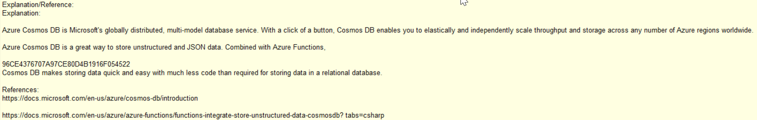
Q11
Tip: CosmosDB can be what you want it to be:
CosmosDB is really three different DBs in one
NoSQL – taking strings like JSON
SQL – handling relational DB
Read the cosmos-db intro
AWS has about 10 different DB.
Microsoft is introducing only CosmosDB.

Slide 25
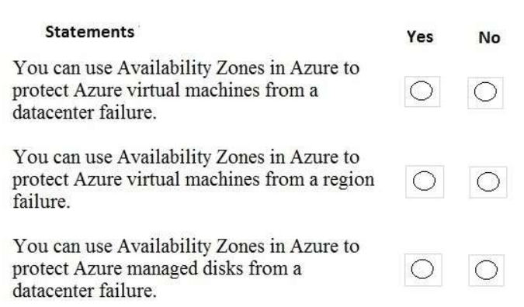
Q12
AZ always in same region!
Consider Region Pairing
if this is critical

Slide 26
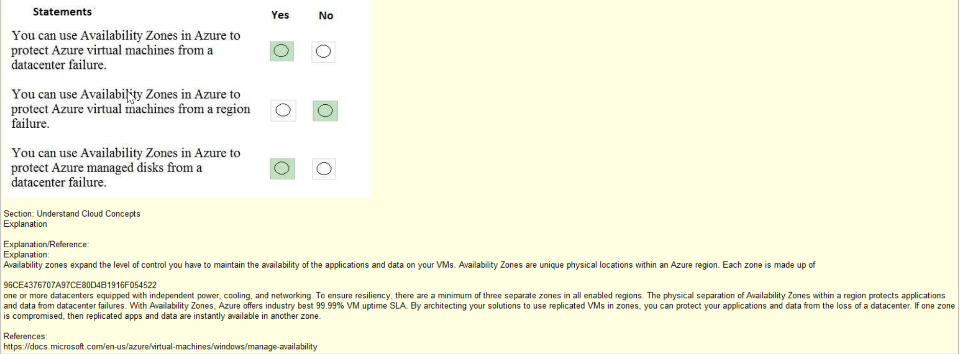

Slide 27
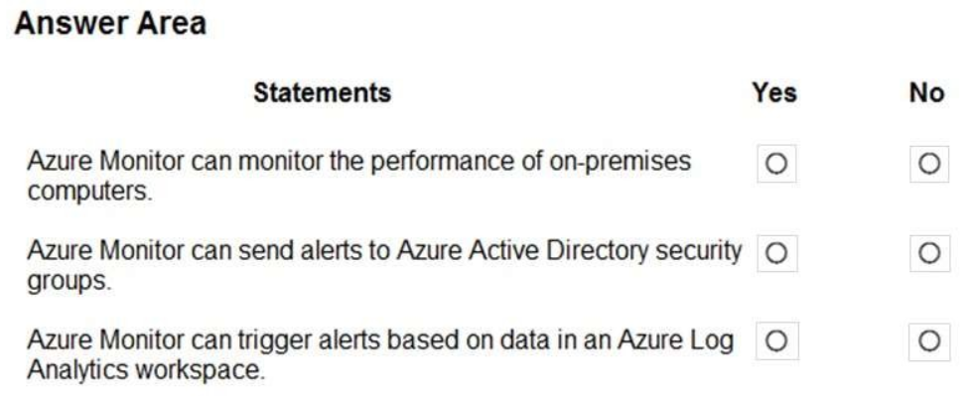
Q13
Source: https://azure.microsoft.com/en-us/services/monitor/#:~:text=How%20Azure%20Monitor%20works.%20Azure%20Monitor%20collects%20monitoring,data%20store%20that%E2%80%99s%20optimized%20for%20cost%20and%20performance.Azure Monitor collects monitoring telemetry from a variety of on-premises and Azure sources.
Azure Monitor
Full observability into your applications, infrastructure, and network
Management tools, such as those in Azure Security Center and Azure Automation, also push log data to Azure Monitor.
The service aggregates and stores this telemetry in a log data store that’s optimized for cost and performance.

Slide 28
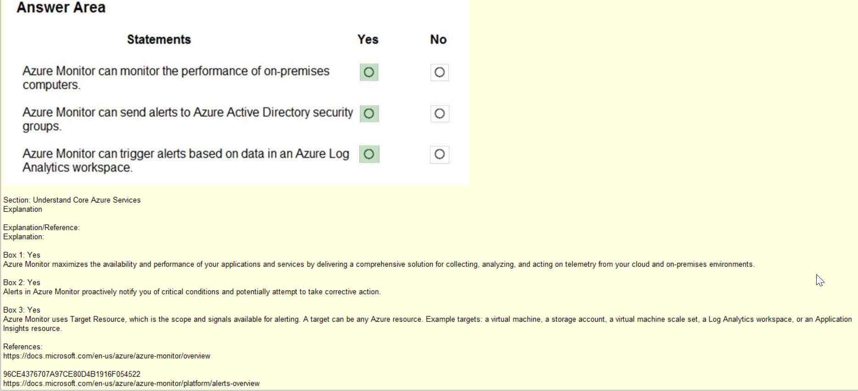

Slide 29
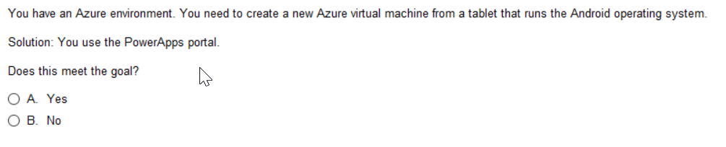
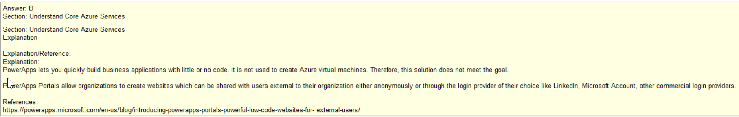
Q14
Tip: Serverless – typically no IaaS needed
Billable only for the time you use it and the
Resources consumed rather than Resources
That are utilized 100% of the time
Microsoft Power Apps on Azure
A powerful, low-code platform for building apps quickly
Powerful tool for creature websites or serverless functions
Virtual Machines are infrastructure, not applications

Slide 30
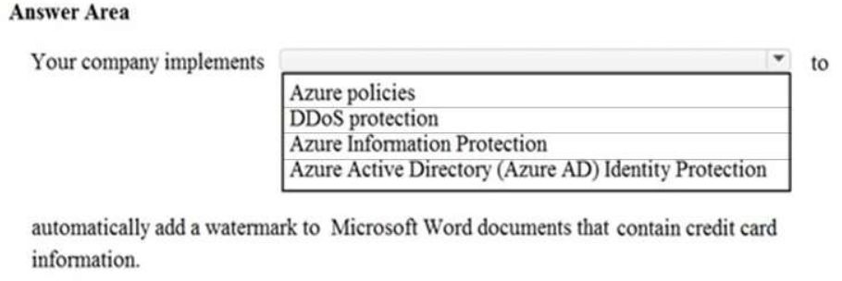
Q15
Tip: Know difference between DDoS (Distributed Denial of Service)
Vs Information Protection (specific PII within docs, ie: SSN or CreditCard Numbers )
Vs Identity Protection – MFA, login security rules like must change pass everytime you access from new location
Vs Azure Policy – must change password every 40 days

Slide 31
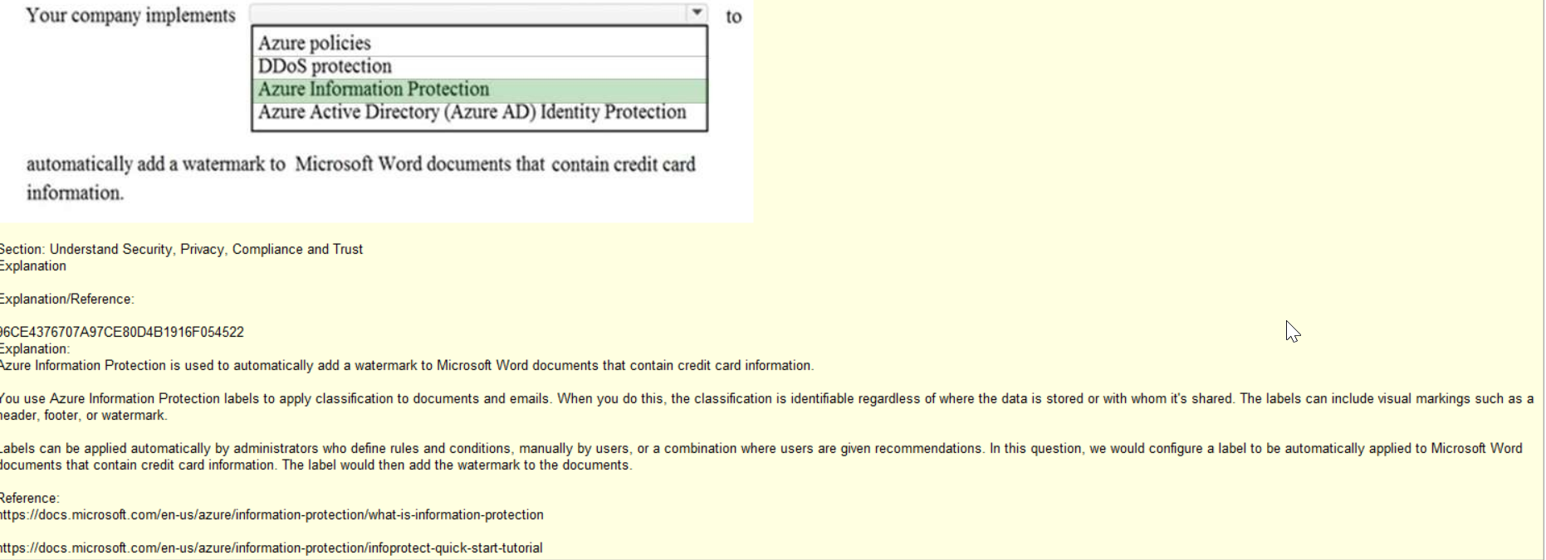
Q16

Slide 32
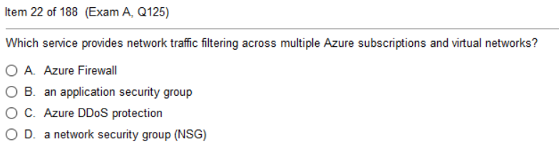
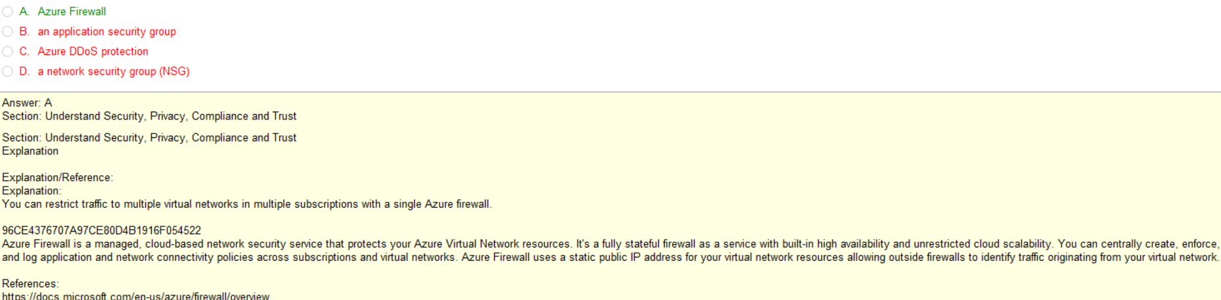
Q17
Tip: Understand concept of FW
And DDoS. It applies to ALL items
Behind it.
Whereas App Sec Group and NSG
Applies only to specific components
(ie VM, App Service, Web App)
Affects ALL services, apps
Affects only what it is applied to DB or Web App
Affects ALL services, apps
Affects only what it is applied to

Slide 33
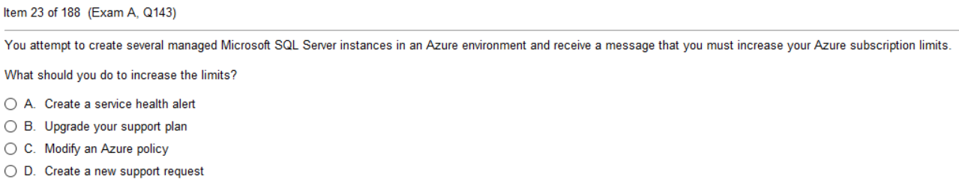
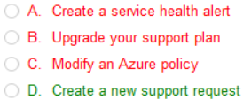
Q18
Tricky: May begin to throttle or fail due to
Lack of resource limits, but if error is about
Reaching subscription limits, you must reach
Out to Microsoft to address.
Very Rare that you would over take the
Subscription limit!

Slide 34
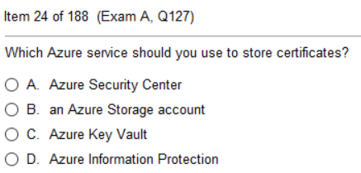
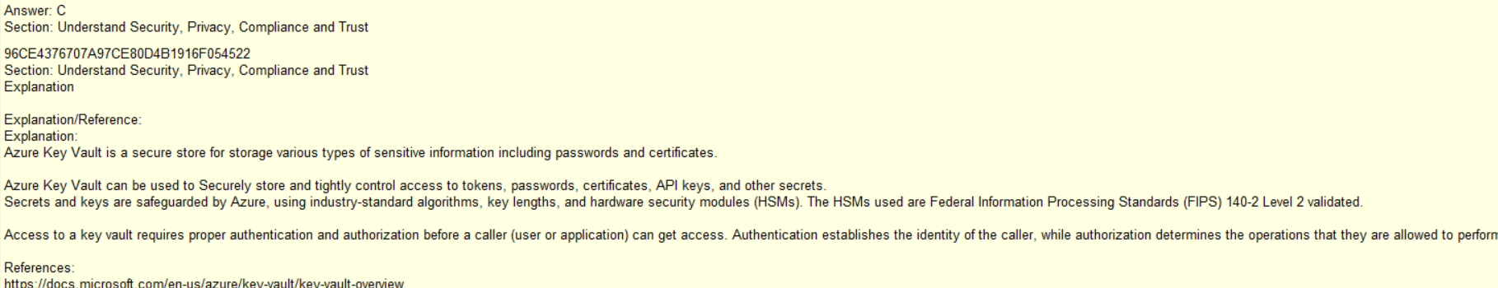
Q19
Where you monitor Security Issues in the Portal, get compliance reports,
configure Security Items,
Possible to store here, but not as secure
Yes – see Desc below, uses algorithms and HSM
Service to protect PII (ie SSN or Credit Card Info)

Slide 35
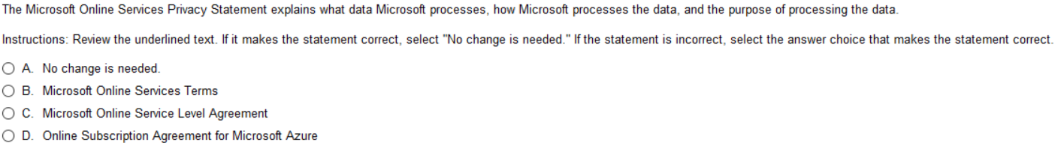
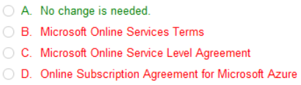
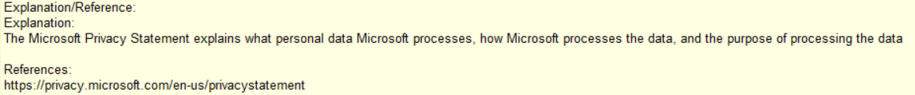
Q20

Slide 36
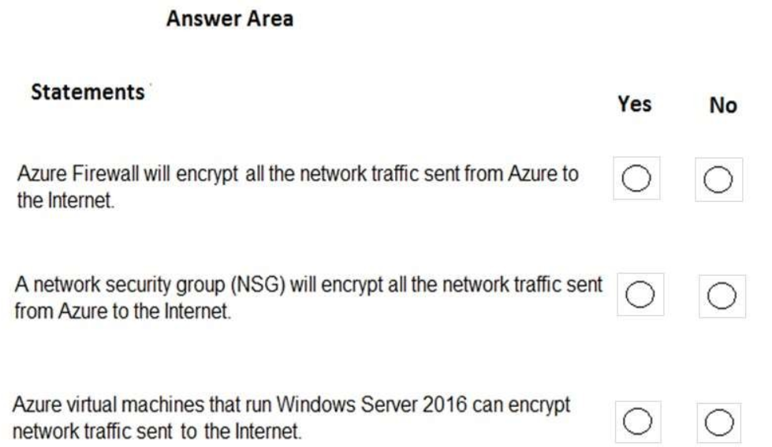
Q21
What does a FW do?
Localized FW to
Specific component?
Tricky, bc it could
See explanation

Slide 37
